Slide 1
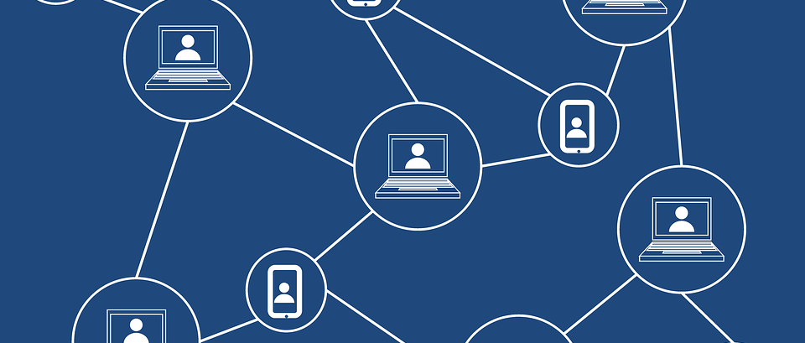
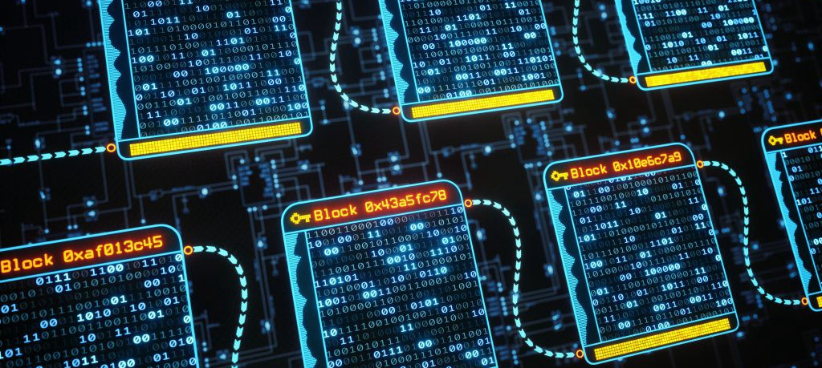
IDENTIFICATION OF COUNTERFEIT PRODUCTS USING BLOCKCHAIN

Slide 2


Presented By:
Adarsh Kumar
Avi Chaurasia
Nitesh Kumar Singh
Project Guide:
Prof. (Dr.) Ambuj Kumar Agarwal
Department Of Computer Science & Engineering
Sharda University, Greater Noida, India

Slide 3
APPROVAL FROM GUIDE FOR THE EVALUATION

Slide 4
CONTENTS OF THE PRESENTATION
Introduction
Motivation
Problem Statement
Objectives
System Design
Results
Conclusion
Reference

Slide 5
INTRODUCTION
Counterfeit products pose significant risks to businesses, consumers, and economies globally. Counterfeit products not only cause financial losses to businesses but also pose significant health and safety risks to consumers. The traditional methods of product identification, such as holograms, watermarks, and serial numbers, are becoming less effective as counterfeiters become more sophisticated. The need for more advanced and secure methods of product identification has become a top priority for businesses and governments worldwide.
Consumers can also use blockchain technology to verify the authenticity of the products they purchase. By scanning a product's unique identifier, consumers can access the blockchain record and verify that the product is genuine. This can help prevent consumers from purchasing counterfeit products, protecting their health and safety, as well as the reputation of the manufacturer.

Slide 6
MOTIVATION
The growing trade in fake goods is having an influence on the sales and profitability of firms affected by this circumstance.
This study is about an operational blockchain system that secures the identity and tracking of authentic products along the supply chain in order to avoid product counterfeiting. Businesses only have to pay very small transaction charges and are liberated from the worry that they might buy counterfeit goods.
The required anti-counterfeiting technology has been suggested before, however, it has not yet been fully built. One such anti-counterfeiting strategy is presented in Maker Chain- A blockchain for self-organizing processes in the communal production of commodities using chemical signatures.
It uses chemical signatures to identify the distinctive characteristics of customized goods. In this study, we suggest using a Blockchain to store product ownership data. By employing blockchain untraceable ability, transparency features.

Slide 7
PROBLEM STATEMENT
Counterfeit products are a major problem for consumers, businesses, and governments around the world. They not only lead to financial losses for companies but also pose health and safety risks for consumers. Blockchain technology can provide a solution to this problem by enabling secure, tamper-proof tracking of product authenticity from the point of manufacture to the point of sale.
Counterfeit products are a growing problem in today's global marketplace. From counterfeit luxury goods to fake pharmaceuticals, these products can lead to significant financial losses for businesses and pose serious risks to consumers' health and safety. In response, many companies are turning to blockchain technology to help identify counterfeit products and prevent their distribution.

Slide 8
OBJECTIVE
The objective of using blockchain technology to identify counterfeit products is to create a secure and transparent system that can track the entire supply chain of a product, from its origin to the end consumer. This system can ensure that the product is authentic and has not been tampered with or replaced with a counterfeit version.
By leveraging the immutability and decentralization of blockchain, each step in the supply chain can be recorded on the blockchain, providing a permanent and transparent record of the product's journey. This record can include information such as the manufacturer, distributor, retailer, and customer, along with any quality control checks, inspections, or certifications that the product has undergone.
Using this information, consumers can verify the authenticity of the product they are purchasing, ensuring that they are not buying a counterfeit version. Additionally, manufacturers can use this system to track and prevent counterfeiting in their supply chain, as any unauthorized changes or substitutions can be easily detected and traced back to their source.

Slide 9
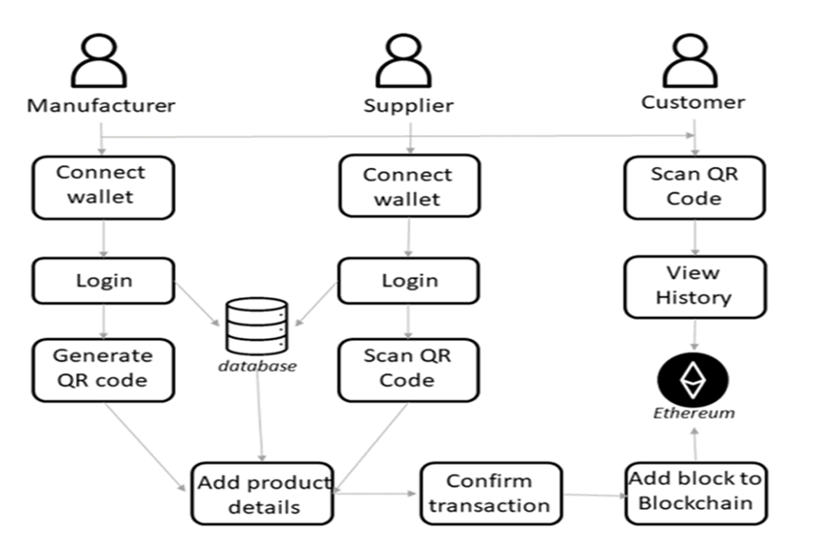
SYSTEM DESIGN
Fig-1 Architecture Supply Chain

Slide 10
Manufacture: A block is added to the Ethereum blockchain using the manufacturer's Ethereum wallet after logging into the manufacturer account to create a QR code for the product and add any further information that is necessary. If both are present, a connection will be made between the wallet addresses of the entity and the user of our local database. If just the block is published to the digital ledger, the manufacturer will enter data from his own account and wallet.
Supplier: After entering into their account as a supplier, the product's QR code is scanned by the supplier. The manufacturer's entered product information is available to the seller. It injects extra information about the item—like the shop's location—into the Blockchain. These details are visible to the buyer.
Customer: Customers can scan a QR code that details the history of transactions and enables them to examine the integrity of a product to confirm its authenticity. The client will be aware that the goods are not genuine if the final location is different from the purchase location at the time of the customer's purchase following the QR scan in the supply chain history. After learning about counterfeiting, the purchaser comes to the conclusion that the QR code was stolen.

Slide 11
QR Code:
QR codes can be used as a unique identifier for products in a blockchain-based system for identifying counterfeit products. Here is how it could work:
Assign a unique QR code to each product: Each product is assigned a unique QR code that is printed on the product or its packaging.
Record the QR code on the blockchain: The QR code is recorded on the blockchain, along with other relevant information such as the date of manufacture, the location of each step in the supply chain, and the identity of the parties involved in each step.
Authenticate the product using the QR code: Consumers can use a smartphone app to scan the QR code and authenticate the product. The app would access the blockchain to retrieve the information recorded during the supply chain tracking phase and use this information to verify the product's authenticity.
Anti-counterfeiting measures: The system can include additional measures to prevent counterfeiting, such as tamper-evident packaging or specialized QR codes that are difficult to replicate.
Enforcement: In cases where counterfeit products are identified, the blockchain can be used to track the source of the counterfeit and help enforce legal action against those involved in the production and distribution of counterfeit products.

Slide 12

RESULT
Fig: 1 Login Page

Slide 13
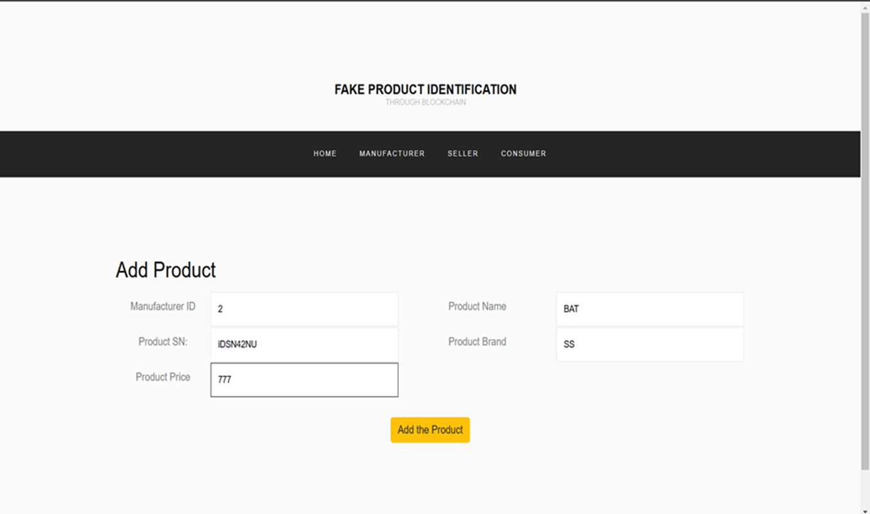
Fig: 2 Add Products Of Manufacturer

Slide 14
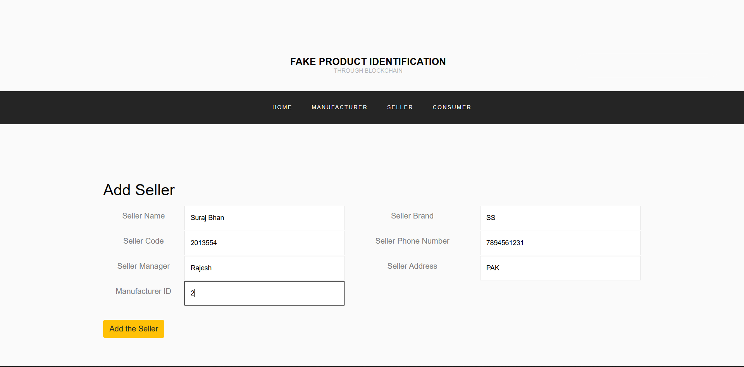
Fig:3 Add Seller

Slide 15
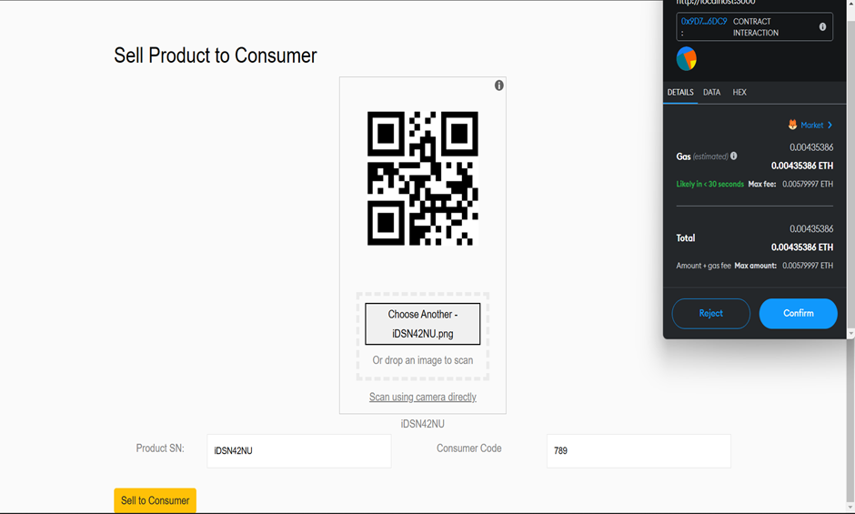
Fig: 4 Sell Products to Consumer

Slide 16
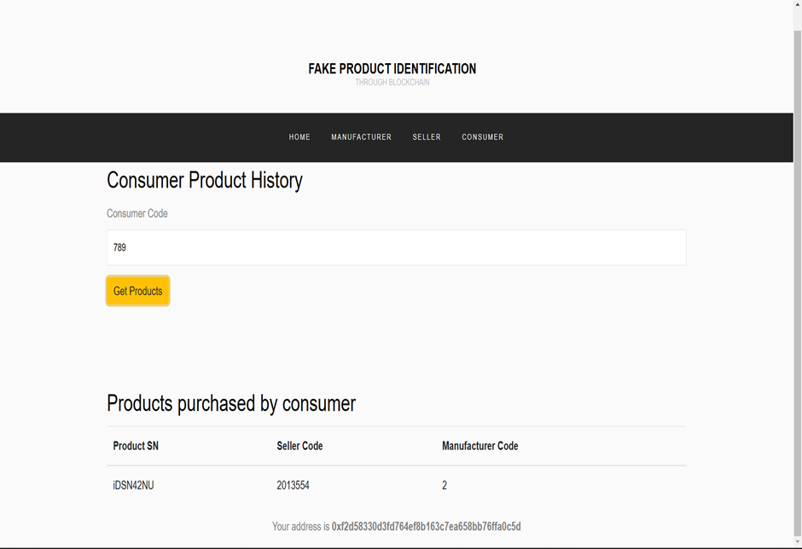
Fig: 5 Consumer Product History

Slide 17
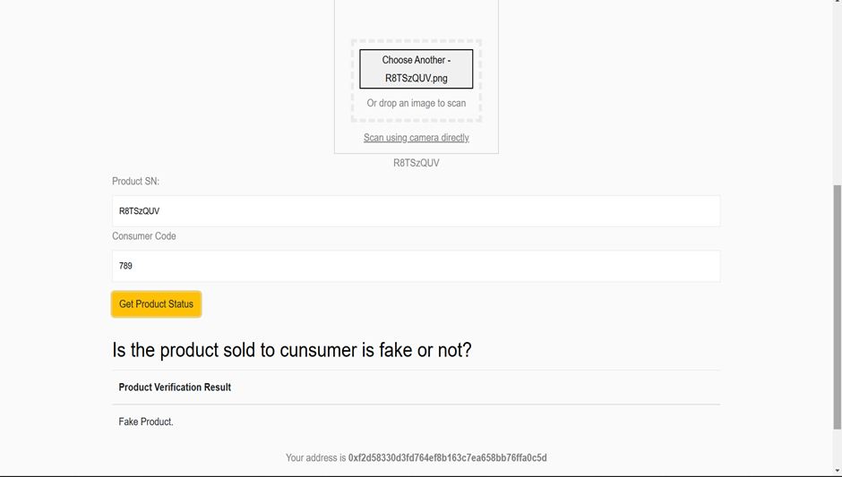
RESULT
Fig: 6 Product Verification

Slide 18
CONCLUSION
identification of counterfeit products using blockchain technology is a promising solution for improving supply chain security and transparency. By leveraging the immutability and transparency of the blockchain, manufacturers, distributors, and consumers can be confident that the products they are dealing with are genuine and have not been tampered with.
The proposed model for identifying counterfeit products using blockchain can provide real-time monitoring of product movement, enable product authenticity verification, identify counterfeit products, generate reports and analytics, assess risk, and improve supply chain efficiency. These model outputs can help to prevent the entry of counterfeit products into the market, improve supply chain management, and protect consumers and brand reputation.
Despite these challenges, the benefits of implementing a blockchain-based solution for identifying counterfeit products are significant and can lead to a more secure, transparent, and efficient supply chain. As such, it is important for manufacturers, distributors, and other stakeholders to consider adopting this technology as part of their broader supply chain management strategies.

Slide 19
REFERENCES
1. N. Satoshi, Bitcoin: A Peer-to-Peer Electronic Cash System, (2008).
2. J. Leng, P. Jiang, K. Xu, Q. Liu, J. L. Zhao, Y. Bian, and R. Shi, ‘‘Maker chain: A blockchain with chemical signature for self-organizing process in social manufacturing,’’ J. Cleaner Prod., vol. 234, pp. 767–778, Oct. 2019.
3. JINHUA MA 1, SHIH-YA LIN 2, XIN CHEN 1, HUNG-MIN SUN 2, YEH-CHENG CHEN 3, (Graduate Student Member, IEEE) AND HUAXIONG WANG 4 A Blockchain-Based Application System for Product Anti-Counterfeiting (2020).
4. Satoshi Nakamoto, Bitcoin: A Peer-to-Peer Electronic Cash System retrieved from bitcoin.org, (2009).
5. N. Alzahrani, Block-supply chain: A brand-new anti-counterfeiting supply chain using NFC and blockchain, (2018).
6.C. Shaik, Computer Science & Engineering: An International Journal (CSEIJ), 4, (2021).

